Slide 1

COVID-19: Our Response
Keith Wrightson AFSCME Health & Safety Specialist

Slide 2

Testified in Juneau as a Subject Matter Expert
Consulted with OSHA, NIOSH and the CDC on Guidance Documents
Hosted (2) COVID-19 Trainings for ASEA
Hosted several more trainings on COVID-19 nationwide
Upcoming Training on COVID-19 Testing November 12, 2020 at 10:00am-11:30am Alaska time See MaryAnn Ganacias for details
AFSCME: Protecting Our Members in the COVID-19 Pandemic

Slide 3

• COVID-19: Best Practices for Returning to an Office Setting
• Cleaning and Decontamination of SARS-CoV-2 on Surfaces
• COVID-19: Interim Guidance for Police, Sheriffs and Law Enforcement Officers
• COVID-19 Preparedness for Long-Term Care Facilities
• Interim Guidance on SARS-CoV-2 for Correctional Officers and Staff in Secured Facilities
• Personal Protective Equipment for Healthcare Workers in a COVID-19 Environment
Visit www.afscmestaff.org to access these fact sheets and much more!

Slide 4

Prevention & Worker Protections
Notes:
Let’s transition and discuss how to protect yourself.

Slide 5
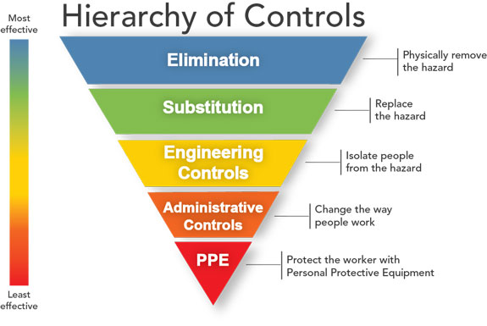

Hazard Prevention & Control
Elimination
Substitution
Engineering controls
Administrative controls
Personal Protective Equipment
Notes:
Elimination and Substitution
Elimination and substitution, while most effective at reducing hazards, also tend to be the most difficult to implement in an existing process. If the process is still at the design or development stage, elimination and substitution of hazards may be inexpensive and simple to implement.
Engineering Controls
Engineering controls are favored over administrative and personal protective equipment (PPE) for controlling existing worker exposures in the workplace because they are designed to remove the hazard at the source, before it comes in contact with the worker.
Administrative Controls and PPE
Administrative controls and PPE are frequently used with existing processes where hazards are not particularly well controlled. Administrative controls and PPE programs may be relatively inexpensive to establish but, over the long term, can be very costly to sustain. These methods for protecting workers have also proven to be less effective than other measures, requiring significant effort by the affected workers.

Slide 6
Universal/Standard Precautions
Treat all human blood and body fluids as if they were infected.
Use of a combination of the following practices depending on contact with the person you care for:
Hand washing
Gloves, masks, eye protection, face shield and gowns
Environmental cleaning
Disinfection of soiled equipment and linens
Disposal for used sharps
Isolation practices
Transmission-based precautions may be needed for certain types of infections, like COVID-19.
Notes:
Universal precautions are an infection control practice. Under universal precautions all patients were considered to be possible carriers of blood-borne pathogens. The guideline recommended wearing gloves when collecting or handling blood and body fluids contaminated with blood, wearing face shields when there was danger of blood splashing on mucous membranes and disposing of all needles and sharp objects in puncture-resistant containers.
Universal precautions were introduced in the US by CDC in the wake of the AIDS epidemic between 1985 and 1988.
In 1987, the practice of universal precautions was adjusted by a set of rules known as body substance isolation. In 1996, both practices were replaced by the latest approach known as standard precautions.
Universal precautions were designed for doctors, nurses, patients, and healthcare workers who came into contact with patients and their bodily fluids. This included staff and others who might not come into direct contact with patients.
Universal precautions were typically practiced in any environment where workers were exposed to bodily fluids, such as Blood, Semen, Vaginal secretions, Synovial fluid, Amniotic fluid, Cerebrospinal fluid, Pleural fluid, Peritoneal fluid, Pericardial fluid, Feces and Urine.
Since pathogens fall into two broad categories, bloodborne (carried in the body fluids) and airborne, personal protective equipment included, but was not limited to barrier gowns, gloves, masks, eyewear like goggles or glasses and face shields.
in addition to universal precautions for patients who were known or suspected to have an infection, and varied depending on the suspected transmission. Additional precautions were not needed for blood-borne infections, unless there were complicating factors.[citation needed]
Conditions demanding additional precautions (transmission based) for diseases like Creutzfeldt–Jakob disease, or diseases with air-borne transmission (e.g., tuberculosis), diseases with droplet transmission (e.g., mumps, rubella, influenza, pertussis, COVID-19) and transmission by direct or indirect contact with dried skin (MRSA) or contaminated surfaces or any combination of the above.

Slide 7
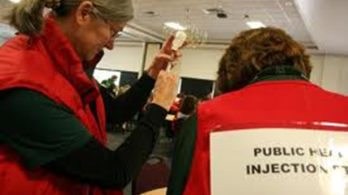
Vaccination
Vaccination key component to prevention
Vaccination rates have dropped in some areas-leading to outbreaks of measles, mumps, pertussis
Notes:
You may not realize that you need vaccines throughout your life. Adults need to keep their vaccinations up to date because immunity from childhood vaccines can wear off over time. You are also at risk for different diseases as an adult. Vaccination is one of the most convenient and safest preventive care measures available.
All adults need:
Influenza (flu) vaccine every year
Td or Tdap vaccine
You may need other vaccines based on your age, health conditions, job, lifestyle, or travel habits. Learn more about what other vaccines may be recommended for you and talk to your healthcare professional about which vaccines are right for you.
Children need many vaccines, we will email you a vaccine schedule when you receive your certificate.

Slide 8
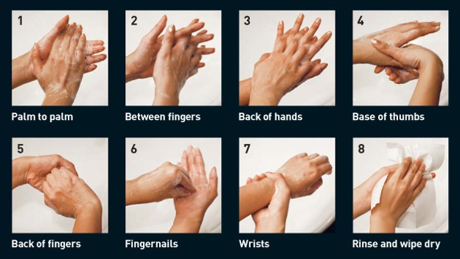
Hand Washing
How Long Does it Take to Properly Wash Your Hands?
Notes:
Walk through the steps of handwashing. Set your own pace. Ask the group to answer the question on the screen via chat.
Answer to question on screen: 20 seconds

Slide 9
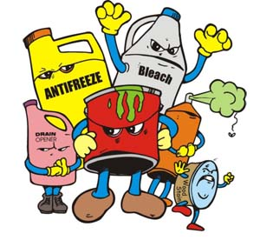
Cleaners & Disinfectants
Cleaners or detergents
Sanitizers
Disinfectants
Read the labels!!!
Notes:
Cleaners or detergents are products that are used to remove soil, dirt, dust, organic matter, and germs (like bacteria, viruses, and fungi).
Cleaners or detergents work by washing the surface to lift dirt and germs off surfaces so they can be rinsed away with water.
The same thing happens when you wash your hands with soap and water or when you wash dishes.
Rinsing is an important part of the cleaning process. Use these products for routine cleaning of surfaces.
Sanitizers are used to reduce germs from surfaces but not totally get rid of them.
Sanitizers reduce the germs from surfaces to levels that considered safe.
Disinfectants are chemical products that destroy or inactivate germs and prevent them from growing.
Disinfectants have no effect on dirt, soil, or dust. Disinfectants are regulated by the U.S. Environmental Protection Agency (EPA).
You can use a disinfectant after cleaning for surfaces that have visible blood or drainage from infected skin.
Read the labels and use the product as directed. These products can be toxic and fatal if not properly used.

Slide 10

Waste Disposal
Use
lined trash can.
Place
used disposable gloves and other contaminated items in a lined trash can.
Wear
gloves when removing garbage bags, and handling and disposing of trash. Wash hands afterwards.
Dispose
Of all used disposable gloves, facemasks, and other contaminated items in a lined trash can.
Dedicate
a lined trash can for the person who is sick.
Notes:
Follow the steps on the screen, move quickly through this.

Slide 11
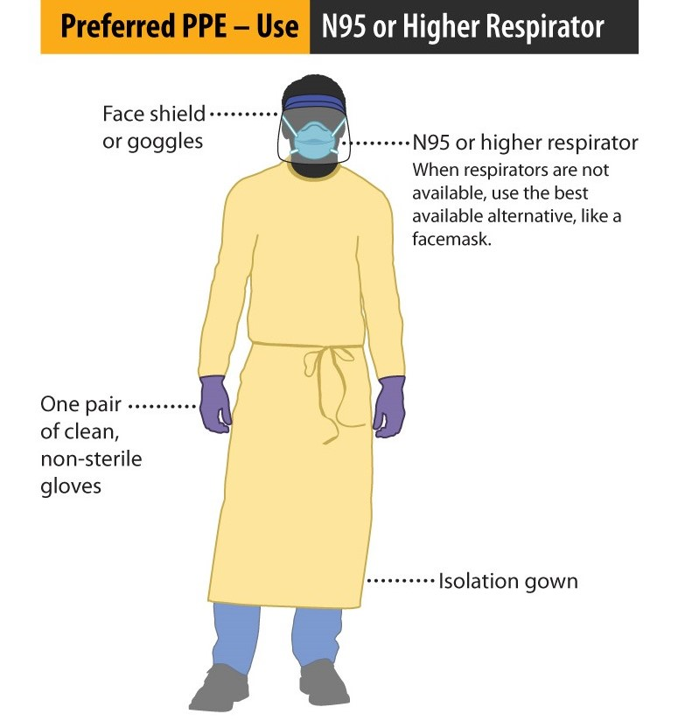
Personal Protective Equipment
When Working With a COVID-19 Patients!
Not all PPE is the Same!
Understand the disease, how it spreads and then select PPE.
Notes:
You must select personal protective equipment (PPE) that will protect yourself against SARS-CoV-2, other pathogens and other hazards associated with chemicals which they may be exposed during cleaning and decontamination of surfaces and objects. What is on the screen is ideal for COVID-19 patients, but you would not need all this PPE for a Hepatitis patient.
Homecare providers must wear PPE to help minimize exposure to the virus and chemicals through inhalation, contact or ingestion.
Examples of PPE that may be needed while caring for a COVID-19 patient or during cleaning and decontamination include:
Nitrile gloves.
Goggles or face shields.
Fluid-resistant or fluid-impermeable gowns, coveralls and aprons.
Dedicated work clothing and washable shoes with shoe or boot covers.
In some cases, additional respiratory protection (e.g., N95, powered air-purifying respirators or better) may be necessary to protect workers from exposure to SARS-CoV-2 or disinfectants.
Workers must receive training on and demonstrate an understanding of:
When to use PPE.
Which PPE is necessary.
How to properly don, use and doff PPE in a manner to prevent self-contamination.
How to properly dispose of or disinfect and maintain PPE.
The limitations of PPE.
Let me simplify things. The boss cannot just give you PPE and claim that you are protected, there are specific rules attached to PPE.
Any reusable PPE must be properly cleaned, decontaminated and maintained after and between uses. Facilities should have policies and procedures describing a recommended sequence for safely donning and doffing PPE.
Depending on the hazards posed by the size of a spill, degree of contamination or other factors, required PPE may be different than what is described in this webinar.

Slide 12
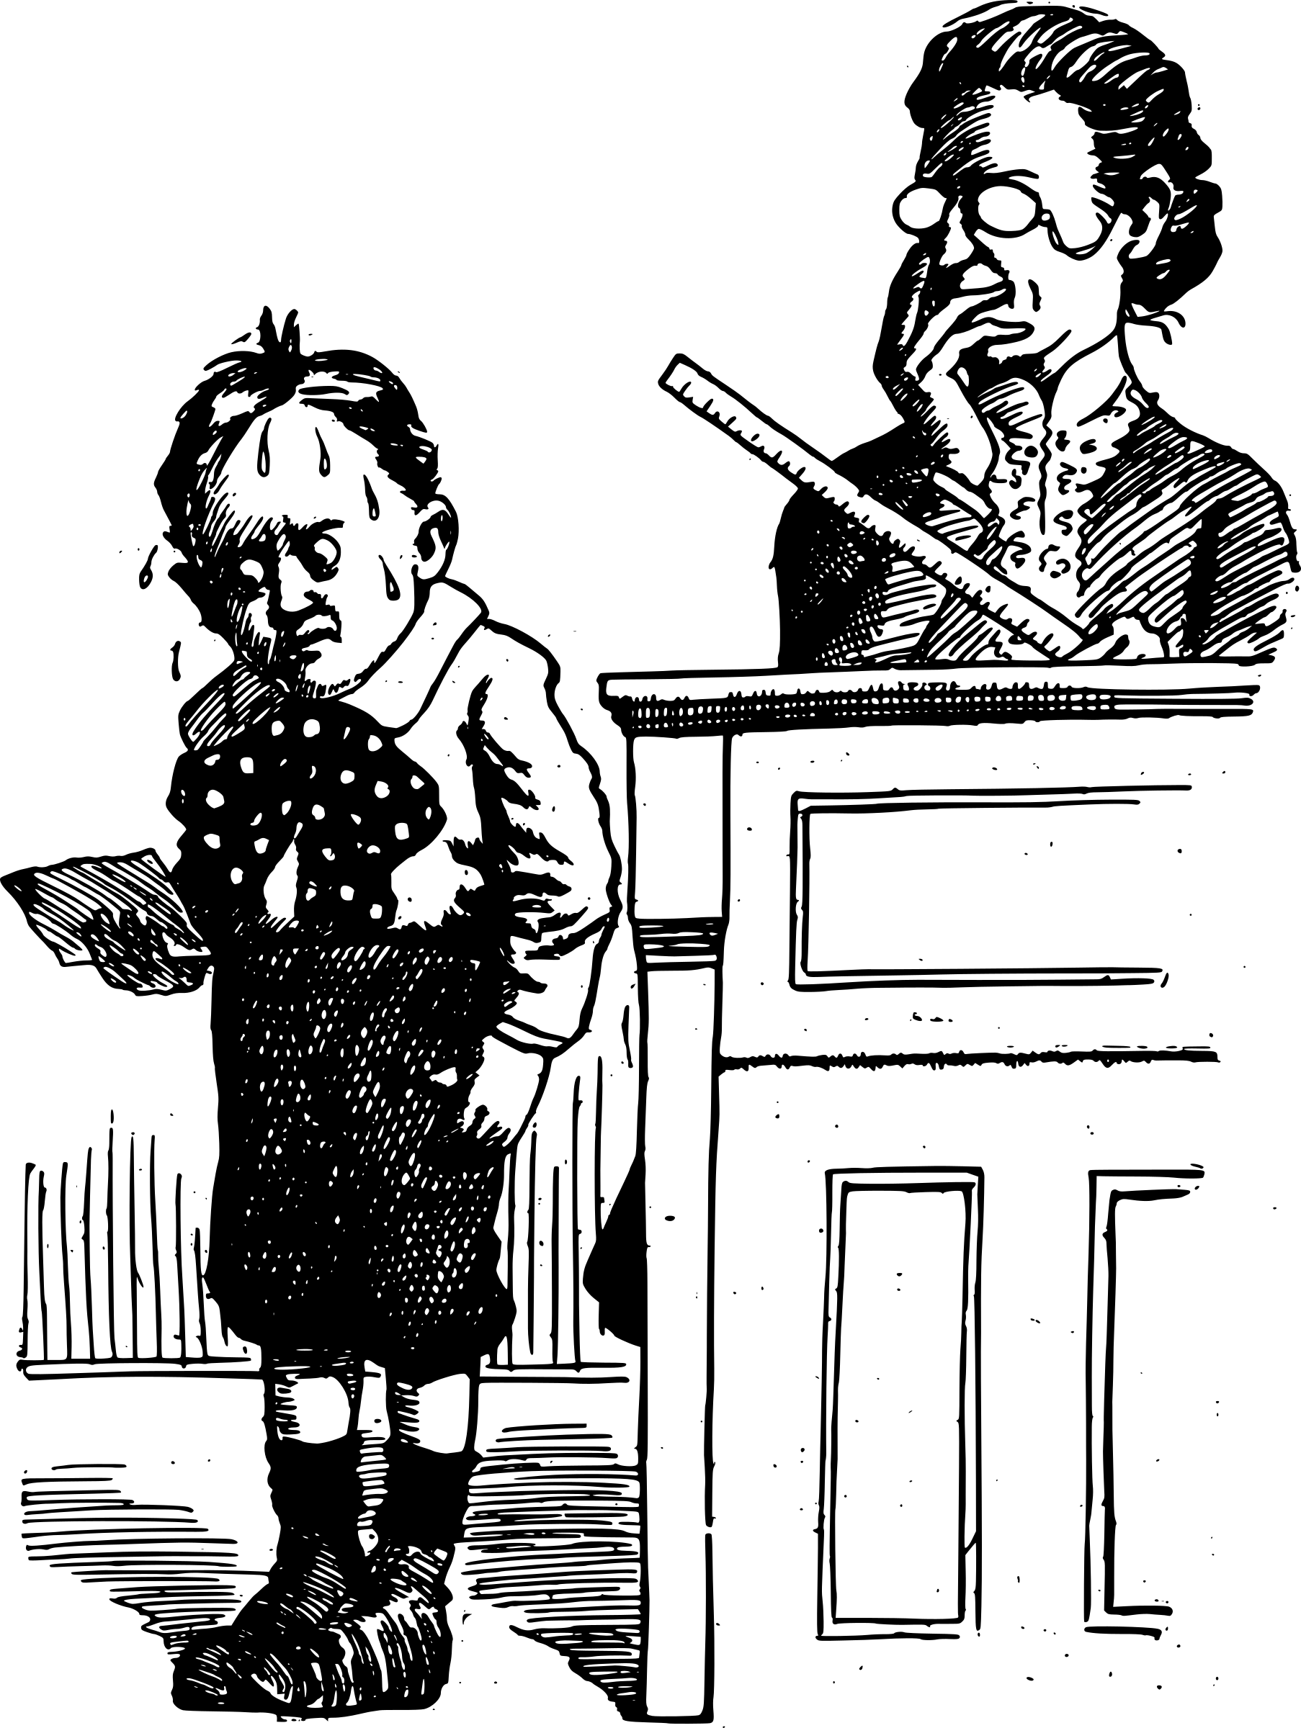
Know Your Rights
You cannot be punished or discriminated against for exercising your rights that have been negotiated by ASEA/Local 52 or under Federal and Alaska law.
This includes:
Firing or laying off, blacklisting, demoting, denying overtime or promotion, disciplining, denial of benefits, failure to hire or rehire, intimidation/harassment, making threats, reassignment affecting prospects for promotion or reducing pay or hours.
Notes:
Instructor to lead a discussion on adverse actions and distribute handout “Your Rights as a Whistleblower.”
Firing or laying off, blacklisting, demoting, denying overtime or promotion, disciplining, denial of benefits, failure to hire or rehire, intimidation/harassment, making threats, reassignment affecting prospects for promotion or reducing pay or hours.
http://www.whistleblowers.gov/know_your_rights.html
You must file the complaint with OSHA within 30 days of the alleged reprisal. If your employer does discriminate or retaliate against you for trying to report an injury or illness, you have the right to file a retaliation complaint with OSHA.

